Slide 1

M I NI P ROJ EC T REP ORT — EM BED D ED S Y STEM S
ESP 32
Web-Based Industrial Process Control System Using ESP32 with Real-Time Dashboard
Using ESP32 with Real-Time Dashboard
Live Monitoring & Control using WebSocket
Platform: ESP32 DevKit V1 + FreeRTOS IDE: Arduino IDE / PlatformIO
2025 – 2026

Slide 2
ABSTRACT
This project presents a Web-based Industrial Process Control System using ESP32.
The system monitors tank level, pressure, and motor RPM in real time.
A WebSocket-based dashboard enables live visualization and remote control of system parameters such as motor speed and tank level setpoints.
Safety is ensured using multi-level alarm logic with automatic relay shutdown.
KEY W O RDS
ESP32 Real-Time OS Multitasking Industrial Automation Sensor Motor Control Scheduler WebSocket Dashboard Alarm Logic

Slide 3





INTRODUCTION
Industrial systems require real-time monitoring, remote control, and safety automation.
The Problem
Traditional bare-metal single-loop programs CANNOT meet multiple concurrent timing constraints in industrial systems.
  The Solution
  Web-Based Industrial Process Control System provides preemptive multitasking, deterministic scheduling & safe resource sharing for concurrent tasks.
01
ESP32 with Wi-Fi and Web Dashboard enables real-time monitoring and control.
02
  Remote control via dashboard
  Automatic safety system and Wireless communication (Wi-Fi)
03
Safe Resource Sharing
04
Modular Code
Each task is an independent, testable unit

Slide 4




SLIDE 4 — SYSTEM OVERVIEW
vAlarmTask
vSensorTask
Priority: 4 — HIGHEST
Period: 10 ms
Core: Core 1
Safety checks, buzzer, relay
Priority: 3 — HIGH
Period: 50 ms
Core: Core 1
ADC/I²C reads — temp & pressure
vMotorTask
vDisplayTask
Priority: 2 — MEDIUM
Period: 100 ms
Core: Core 0
PWM speed control via BTS7490
Priority: 1 — LOW
Period: 500 ms
Core: Core 0
Web Dashboard
← Core 1 (Safety-Critical)
← Core 0 (Control & UI)

Slide 5






COMPONENTS REQUIRED
Microcontroller
Sensors
  ESP32-S3 DevKitC — 240 MHz Dual-Core, 320KB SRAM, Enhanced FreeRTOS
  DHT22 — Temp/Humidity (GPIO27)
  BMP390 — Pressure + Temp (I²C);
  HC-SR04 (Ultrasonic Level)
  Proximity Sensor
  Potentiometer
Actuators
Alarms & Display
  BTS7960 Motor Driver
  DC Motor
  Relay Module
  Red, Yellow, Green LEDs
  Buzzer
  Web Interface

Slide 6
ESP32 DEVKIT SPECIFICATIONS
CPU | Xtensa LX6 Dual-Core @ 240 MHz
RAM | 520 KB SRAM
Flash | 4 MB SPI Flash
GPIO Pins | 34 programmable GPIO
ADC | 12-bit, 18 channels (ADC1& ADC2)
PWM | 16 independent LEDC channels
I²C / SPI / UART | 2 / 4 / 3 controllers
RTOS | FreeRTOS v10.x (built into ESP-IDF)
Wi-Fi | 802.11 b/g/n 2.4 GHz
Bluetooth | BT 4.2 + BLE
Op. Voltage | 3.3V logic, 5V USB input
Op. Temp | -40°C to +85°C
Key Advantage: ESP32 runs FreeRTOS natively. Safety-critical tasks are pinned to Core 1 using xTaskCreatePinnedToCore() | Key Advantage: ESP32 runs FreeRTOS natively. Safety-critical tasks are pinned to Core 1 using xTaskCreatePinnedToCore()

Slide 7
FREERTOS TASK ARCHITECTURE
Task Hierarchy & IPC Objects
Task Name | Priority | Stack | Period | Core | IPC Object
vAlarmTask | 4 — Highest | 2048 | 10 ms | Core 1 | Semaphore (take)
vSensorTask | 3 — High | 3072 | 50 ms | Core 1 | Queue (send) + Sem. (give)
vMotorTask | 2 — Medium | 2048 | 100 ms | Core 0 | Queue (receive)
vDisplayTask | 1 — Low | 4096 | 500 ms | Core 0 | Queue (peek)
IPC Objects Used
xSensorQueue [Queue (depth 5)] Sensor → Motor & Display:pass SensorData_tstruct
xAlarmSemaphore [Binary Semaphore] Sensor task gives → Alarm task takes for emergency stop
xMotorMutex [Mutex] Protects PWM write access between Motor & Alarm tasks

Slide 8
CIRCUIT CONNECTIONS — PIN MAPPING
GPIO14 | Proximity Sensor | RPM OF MOTOR
GPIO32 | Potentiometer | Manual setpoint (0–3.3V)
GPIO35/34 | BMP280 | Shared I²C SDA/SCL
GPIO33/25 | BTS7960 RPWM/LPWM | Motor PWM speed
GPIO26 | BTS7960 R_EN | Motor direction control
GPIO37 | BTS7960 L_EN | Motor direction control
GPIO37
GPIO23 | Relay IN | Emergency shutdown
GPIO22 | Active Buzzer | Alarm audio output
GPIO22
GPIO5/18/19 | Red / Yellow / Green LED | Critical / Warning / Normal
GPIO4/52 | HC-SR04 TRIG / ECHO | Ultrasonic tank level
GPIO34 & GPIO35 are input-only pins — ideal forADC sensors. Neverdrive them as outputs.

Slide 9





SYSTEM WORKING PRINCIPLE
Boot Sequence
Alarm Zone Logic
1
ESP32 powers on — setup() initializes I²C, ADC, PWM channels
Zone | Temperatu re | Pressure | Action
Normal | < 60°C | < 1.1 bar | Green LED; normal PWM
Warning | 60–80°C | 1.1–1.3 bar | Yellow LED; 85% speed
ALARM | > 80°C | > 1.3 bar | Red LED + Buzzer + Relay + STOP
Motor PI Control Proportional-Integral controller regulates motor (cooling pump)speed based on temperature. As temp rises toward warning zone, motor ramps up. On alarm:motor halts — requires manual serial reset. | Motor PI Control Proportional-Integral controller regulates motor (cooling pump)speed based on temperature. As temp rises toward warning zone, motor ramps up. On alarm:motor halts — requires manual serial reset. | Motor PI Control Proportional-Integral controller regulates motor (cooling pump)speed based on temperature. As temp rises toward warning zone, motor ramps up. On alarm:motor halts — requires manual serial reset. | Motor PI Control Proportional-Integral controller regulates motor (cooling pump)speed based on temperature. As temp rises toward warning zone, motor ramps up. On alarm:motor halts — requires manual serial reset.
2
GPIO, PWM, ADC initialized
3
Wi-Fi and WebSocket server started
4
Sensors begin reading
5
Dashboard connects
6
Continuous control loop starts

Slide 10
TESTING & RESULTS
# | Test Scenario | Expected Result | Result | Observation
1 | Power-on (25°C normal) | Green LED, 30% PWM, OLED readings | PASS | All tasks initialized within 2 ms
2 | Temp > 80°C | Red LED, buzzer, relay, motor stop | PASS | Alarm triggered within 10 ms
3 | Pressure > 1.3 bar (BMP280) | Same alarm actions as Test 2 | PASS | Dual-threshold protection confirmed
4 | Return to normal temp < 60°C | Green LED, motor restarts | PASS | Manual serial reset required
5 | Serial monitor — normal ops | Sensor data every 50 ms | PASS | Clean UART @ 115200 baud
6 | Web UI will show during alarm state | ALARM in red blink | PASS | Display updates on 500 ms cycle
7 | Disconnect BMP280 mid-run | Last known value, error log | PASS | No crash — graceful degradation
CPU Utilization: Alarm 5.0% + Sensor 6.0% + Motor 2.0% + Display 1.6% = — Well ʷᶦᵗʰᶦⁿ RMS bound of 69.3% for 4 | CPU Utilization: Alarm 5.0% + Sensor 6.0% + Motor 2.0% + Display 1.6% = — Well ʷᶦᵗʰᶦⁿ RMS bound of 69.3% for 4 | CPU Utilization: Alarm 5.0% + Sensor 6.0% + Motor 2.0% + Display 1.6% = — Well ʷᶦᵗʰᶦⁿ RMS bound of 69.3% for 4 | CPU Utilization: Alarm 5.0% + Sensor 6.0% + Motor 2.0% + Display 1.6% = — Well ʷᶦᵗʰᶦⁿ RMS bound of 69.3% for 4 | CPU Utilization: Alarm 5.0% + Sensor 6.0% + Motor 2.0% + Display 1.6% = — Well ʷᶦᵗʰᶦⁿ RMS bound of 69.3% for 4
14.6%
tasks

Slide 11



APPLICATIONS & CONCLUSION
Applications
Conclusion
  Industrial boiler / furnace temperature control
  Chemical plant — pressure vessel safety shutdown
  Water treatment — pump & level sensor control
  HVAC — multi-zone temperature management
  Conveyor belt speed regulation with fault detection
  Food processing — cold chain temperature monitoring
  Educational RTOS lab experiments
This project demonstrates a real-time industrial control system using ESP32 and a Web Dashboard.
The system provides:
  Real-time monitoring
  Remote control
  Safety automation
  WebSocket ensures fast communication.
Future Enhancements
  Cloud integration
  Mobile app
  Data logging
  AI prediction

Slide 12
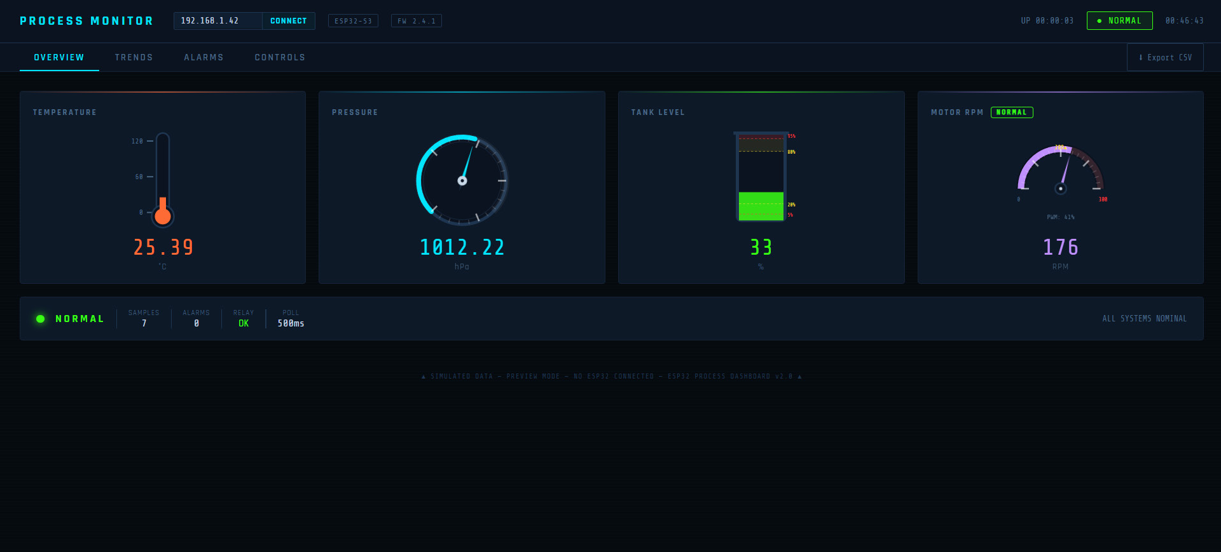
WEB DASHBOARD
  Real-time monitoring
  Setpoint control
  Alarm visualization
  WebSocket communication

